Slide 1
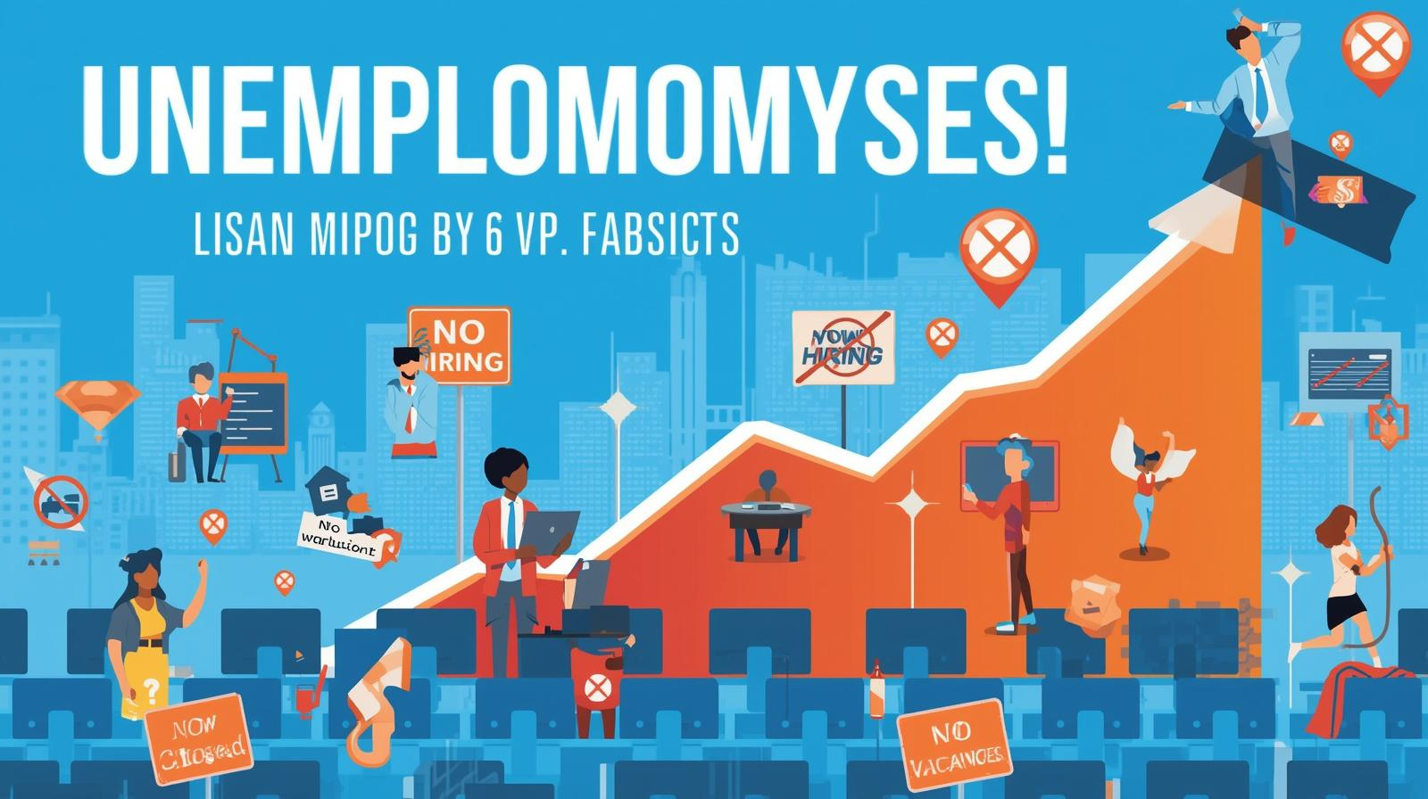


PROJECT
UDYOGA
Group - 12

Slide 2


DECODING UNEMPLOYMENT: AN OVERVIEW
DEFINITION
Individuals who are without work but actively searching for a job.
KEY METRIC
ECONOMIC IMPACT
The Unemployment Rate: Percentage of the total labour force that is unemployed.
economic health and societal well-being.

Slide 3



THE SPECTRUM OF JOBLESSNESS: TYPES OF UNEMPLOYMENT
Cyclical
Linked tobusiness cycles, rising during recessions, falling during economic booms.
Frictional
Short-term;occurs when workers are voluntarily moving
between jobs or entering the workforce.
Structural
Seasonal
Mismatchbetween workers' skills and the jobs available, often due to technological shifts.
Occurs inindustries with predictable, fluctuating labour
needs throughout the year.

Slide 4


Slide 5


THE VICIOUS CYCLE: CAUSES AND IMPACTS OF UNEMPLOYMENT
01
Root Causes
Economicslowdown and recessions Rapid technological change and automation Lack of adequate education and skill training Global competition and trade imbalances Labour market rigidities and policy issues
02
Societal Impacts
Reduced GDP and national output Increased poverty and income inequality Higher crime rates and social unrest Loss of human capital and worker morale Increased burden on public welfare systems

Slide 6
Strategic Interventions: Paths to Employment Growth
1
2
3
4
Government Initiatives
Skill Development
Entrepreneurship
Innovation & Technology

Slide 7


Slide 8


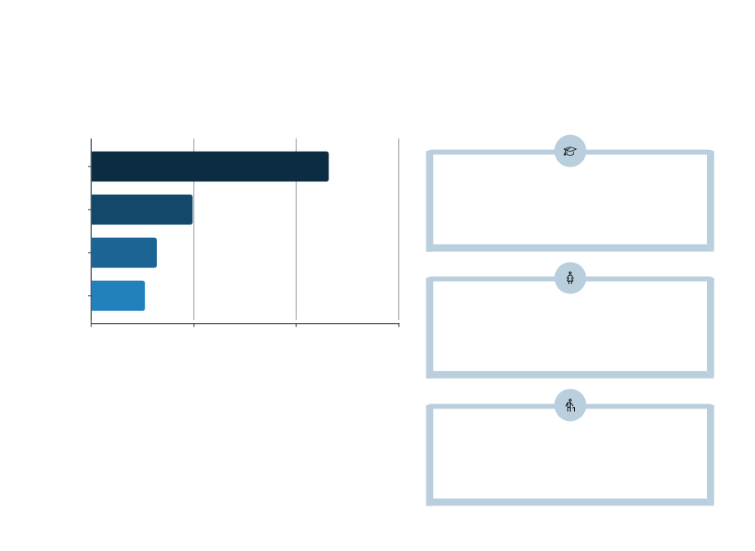
Disparities in the Labour Market: Age and Gender Gaps
Unemployment rates often show significant variations across different demographic groups.
Youth (15-24)
Youth Challenge
Women
Lackofexperienceand insufficient entry-level
positions hinder young graduates.
Men
Older Workers
Gender Inequality
Societalbarriers,unequal pay, and lack of flexible
work options limit female participation.
Older Workers
Risk ofdisplacement due to outdated skills or
age discrimination.

Slide 9


Slide 10


Building Prosperity: The Key Solutions for Unemployment
Education Reform
Fiscal Stimulus
Integrating vocationalandtechnical
Targeted publicspending to boost
skills earlyinthecurriculum.
economic activityandjob demand.
Labour Reforms
MSME Support
Streamlining regulations and offering easy credit for Micro, Small,
Flexible policiesthatencourage
hiring while protecting workers'
rights.
andMedium Enterprises.
Global Integration
Digital Upskilling
Promotingexportsand attracting
Mass training in data science,AI,and cloud computing for future workforce
foreign direct investment (FDI) for local jobs.

Slide 11






TEAM MEMBERS
Arvind Keerthipati
Vaishnavi Boompally
Navneeth Joshi
Geethika Muppuri
Aaron Loeb

